Slide 1

Capstone Exploratory Graphs By: Gabriel Castillo
This Photo by Unknown Author is licensed under CC BY-SA

Slide 2
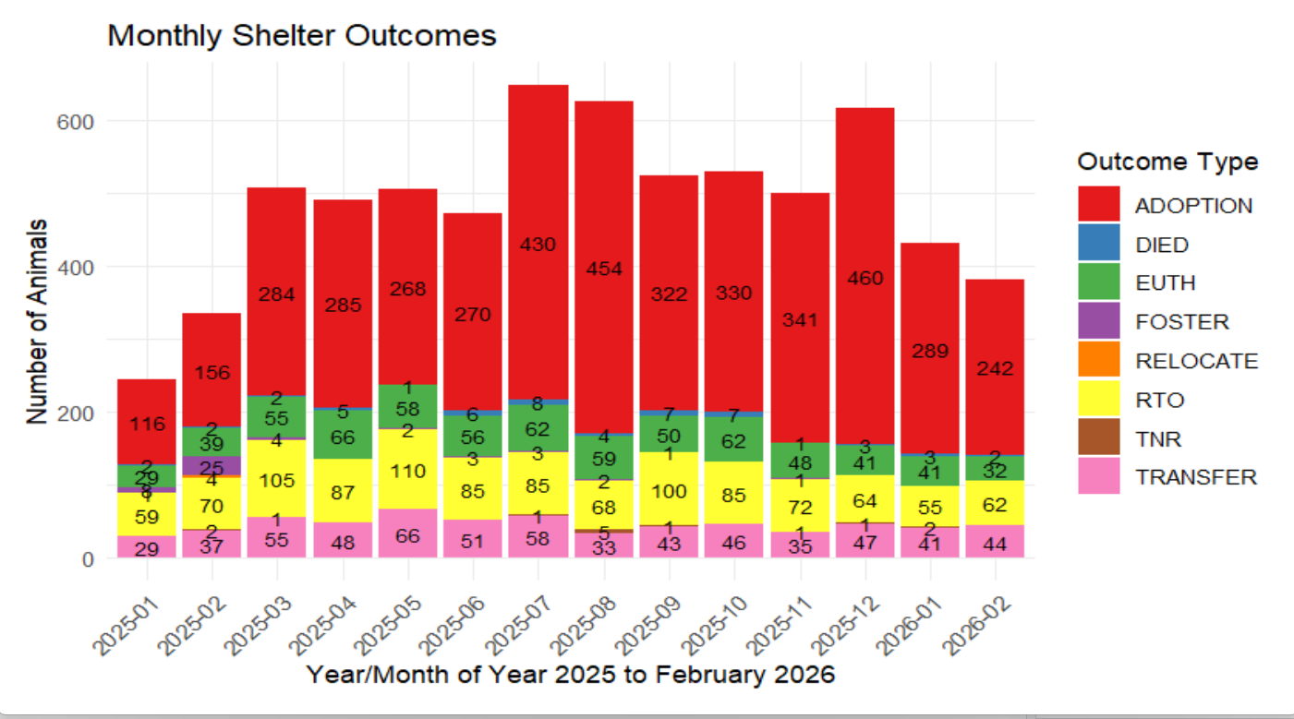
First Visualization:

Slide 3
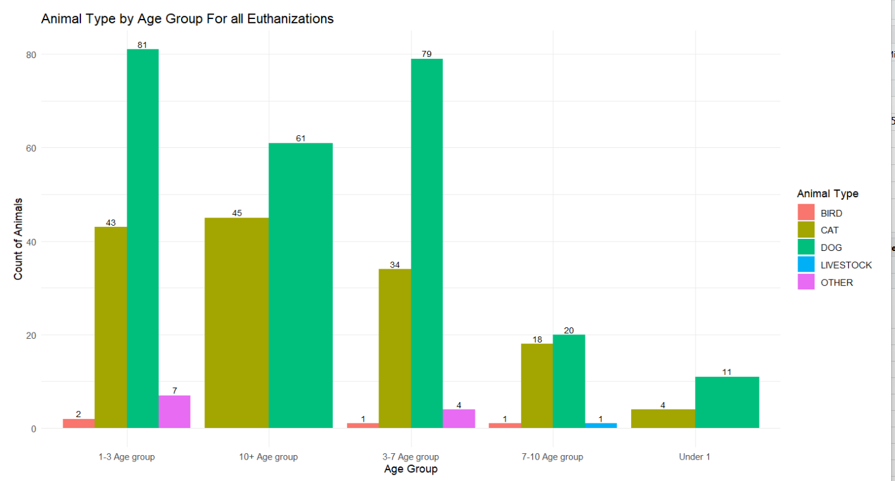
Second Visualization:

